Slide 1

Leveraging Cloud Computing

Slide 2
Types of Services
Infrastructure Services
Servers, Storage, Communications , Connectivity
Utility Services
Data Management, Development Tools, Development Services
Functional Services
Software packages, Custom Solutions, Components

Slide 3
Potential Benefits
Scale
Agility (speed + flexibility)
Reduced complexity
Improved productivity

Slide 4
Potential Challenges
Domain knowledge
Transparency
Reliability / SLAs (still evolving)
Security & Compliance (still evolving)
Extended Help Desk (Customer Service)

Slide 5
A Few Risks
Virtualization for network, computing, and storage may not scale…
Pay for services you may not need
Vendor “lock-in”
Lack of carrier-grade services for Tier 1 systems and/or their dependent systems
Potential for single point of failure

Slide 6
Don’t rely on instruments to fly …
Need to guide your investments carefully in this space. Best to experiment first and get a feel for the benefits, challenges, and risks.
Price versus Value based decisions will yield very different outcomes as they are based on completely different models.

Slide 7
Shift Happens…
Collaboration is where most organizations expand into virtual computing services. This is also where the challenge & adventure begins.
Cloud computing providers and solutions are a natural extension of collaboration.
Collaboration touches upon most areas of computing services and business services.
The 4 walls disappear so you need to rethink your computing & business architectures.

Slide 8
A Few Preparations …
Enterprise Architecture will come in handy
Contingency Planning needs to be revisited
Business Services need to be orchestrated, managed, and monitored in new ways
Need to innovate the security model
Abstraction will be a key measure of success

Slide 9
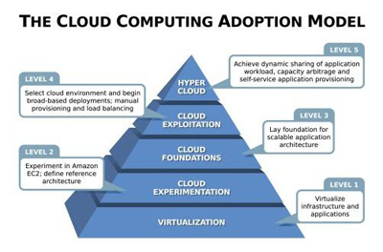
Let the Dialog Begin…

